Slide 1
CS162 Operating Systems and Systems Programming Lecture 21 Layering, E2E Argument
April 11th, 2018
Profs. Anthony D. Joseph & Jonathan Ragan-Kelley
http://cs162.eecs.Berkeley.edu

Slide 2
Centralized vs Distributed Systems
Server
Client/Server Model
Peer-to-Peer Model
Centralized System: System in which major functions are performed by a single physical computer
Originally, everything on single computer
Later: client/server model

Slide 3
Centralized vs Distributed Systems
Server
Client/Server Model
Peer-to-Peer Model
Distributed System: physically separate computers working together on some task
Early model: multiple servers working together
Probably in the same room or building
Often called a “cluster”
Later models: peer-to-peer/wide-spread collaboration

Slide 4
Distributed Systems: Motivation/Issues/Promise
Why do we want distributed systems?
Cheaper and easier to build lots of simple computers
Easier to add power incrementally
Users can have complete control over some components
Collaboration: much easier for users to collaborate through network resources (such as network file systems)
The promise of distributed systems:
Higher availability: one machine goes down, use another
Better durability: store data in multiple locations
More security: each piece easier to make secure

Slide 5
Distributed Systems: Reality
Reality has been disappointing
Worse availability: depend on every machine being up
Lamport: “a distributed system is one where I can’t do work because some machine I’ve never heard of isn’t working!”
Worse reliability: can lose data if any machine crashes
Worse security: anyone in world can break into system
Coordination is more difficult
Must coordinate multiple copies of shared state information (using only a network)
What would be easy in a centralized system becomes a lot more difficult

Slide 6
Distributed Systems: Goals/Requirements
Transparency: the ability of the system to mask its complexity behind a simple interface
Possible transparencies:
Location: Can’t tell where resources are located
Migration: Resources may move without the user knowing
Replication: Can’t tell how many copies of resource exist
Concurrency: Can’t tell how many users there are
Parallelism: System may speed up large jobs by splitting them into smaller pieces
Fault Tolerance: System may hide various things that go wrong
Transparency and collaboration require some way for different processors to communicate with one another

Slide 7
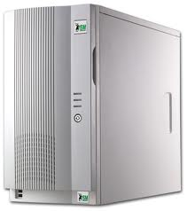
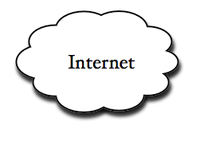
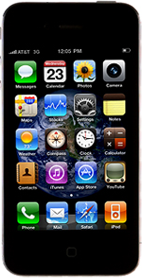
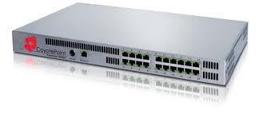
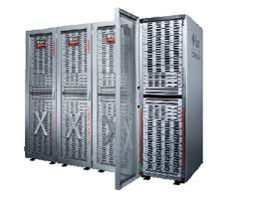
Example: What’s in a Search Query?
DNS
Servers
Datacenter
DNS
request
create
result
page
Search
Index
Load
balancer
Ad Server
Complex interaction of multiple components in multiple administrative domains

Slide 8
Goals for Today
Layering
End-to-end arguments
Some slides generated from Vern Paxson and Scott Shenker lecture notes

Slide 9
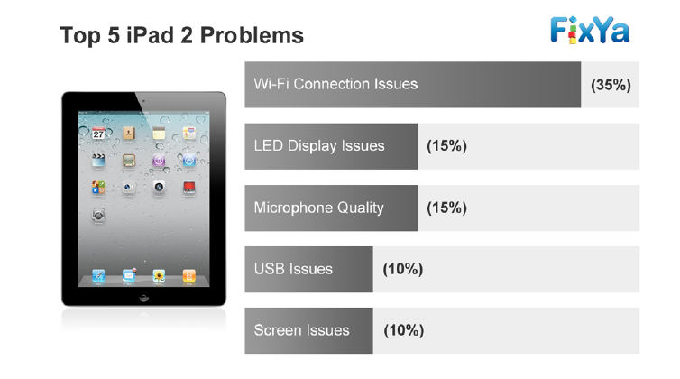
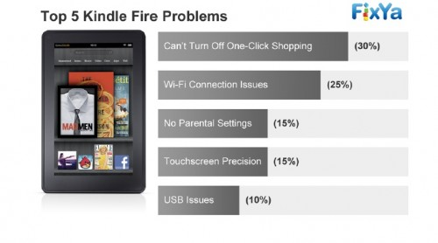
Why is Networking Important?
Virtually all apps you use communicate over network
Many times main functionality is implemented remotely (e.g., Google services, Amazon, Facebook, Twitter, …)
Thus, connectivity is key service provided by an OS
Many times, connectivity issues → among top complaints

Slide 10
Why is Networking Important?
Virtually all apps you use communicate over network
Many times main functionality is implemented remotely (e.g., Google services, Amazon, Facebook, Twitter, …)
Thus, connectivity is key service provided by an OS
Many times, connectivity issues → among top complaints
Some of the hottest opportunities in the OS space:
Optimize OS for network elements (e.g., intrusion detection, firewalls)
OSes for Software Defined Networks (SDNs)

Slide 11
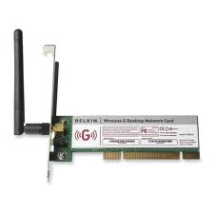
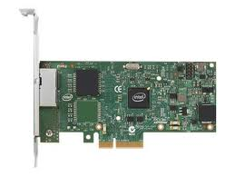
Network Concepts
Network (interface) card/controller: hardware that physically connects a computer to the network
A computer can have more than one networking cards
E.g., one card for wired network, and one for wireless network
Process
A
Process
B
OS
OS
Network cards

Slide 12
Network Concepts (cont’d)
Typically, each network card is associated two addresses:
Media Access Control (MAC), or physical, address
IP, or network, address (can be shared by network cards on same host)
Process
A
Process
B
IP Addr2
MAC Addr2
IP Addr3
MAC Addr3
OS
OS
IP Addr1
MAC Addr1
Network cards

Slide 13
Network Concepts (cont’d)
MAC address: 48-bit unique identifier assigned by card vendor
IP Address: 32-bit (or 128-bit for IPv6) address assigned by network administrator or dynamically when computer connects to network
Process
A
Process
B
IP Addr2
MAC Addr2
IP Addr3
MAC Addr3
OS
OS
IP Addr1
MAC Addr1
Network cards

Slide 14
Network Concepts (cont’d)
Connection: communication channel between two processes
Each endpoint is identified by a port number
Port number: 16-bit identifier assigned by app or OS
Globally, an endpoint is identified by (IP address, port number)
Process
A
Process
B
Connection
PortA
PortB
IP Addr2
MAC Addr2
IP Addr3
MAC Addr3
OS
OS
IP Addr1
MAC Addr1
Network cards

Slide 15
Main Network Functionalities
Delivery: deliver packets between any two hosts in the Internet
E.g., how do you deliver a packet from a host in Berkeley to a host in Tokyo?
Reliability: tolerate packet losses
E.g., how do you ensure all bits of a file are delivered in the presence of packet loses?
Flow control: avoid overflowing the receiver buffer
Recall our bounded buffer example: stop sender from overflowing buffer
E.g., how do you ensure that a sever that can send at 10Gbps doesn’t overwhelm a 4G phone?
Congestion control: avoid overflowing the buffer of a router along the path
What happens if we don’t do it?

Slide 16
Protocol Standardization
Ensure communicating hosts speak the same protocol
Standardization to enable multiple implementations
Or, the same folks have to write all the software
Standardization: Internet Engineering Task Force
Based on working groups that focus on specific issues
Produces “Request For Comments” (RFCs)
Promoted to standards via rough consensus and running code
IETF Web site is http://www.ietf.org
RFCs archived at http://www.rfc-editor.org
De facto standards: same folks writing the code
P2P file sharing, Skype, <your protocol here>…

Slide 17
Layering: The Problem
Many different applications
email, web, P2P, etc.
Many different network styles and technologies
Circuit-switched vs packet-switched, etc.
Wireless vs. wired vs optical, etc.
How do we organize this mess?

Slide 18
The Problem (cont’d)
Application
Skype
SSH
NFS
HTTP
Transmission
Media
Coaxial
cable
Fiber
optic
Radio
Re-implement every application for every technology?
No! But how does the Internet design avoid this?

Slide 19
Solution: Intermediate Layers
Introduce intermediate layers that provide set of abstractions for various network functionality & technologies
A new app/media implemented only once
Variation on “add another level of indirection”
Application
Skype
SSH
NFS
HTTP
Intermediate
layers
Transmission
Media
Coaxial
cable
Fiber
optic
Packet
radio

Slide 20
Software System Modularity
Partition system into modules & abstractions:
Well-defined interfaces give flexibility
Hides implementation - thus, it can be freely changed
Extend functionality of system by adding new modules
E.g., libraries encapsulating set of functionality
E.g., programming language + compiler abstracts away not only how the particular CPU works …
… but also the basic computational model
Well-defined interfaces hide information
Isolate assumptions
Present high-level abstractions
But can impair performance

Slide 21
Network System Modularity
Like software modularity, but:
Implementation distributed across many machines (routers and hosts)
Must decide:
How to break system into modules
Layering
What functionality does each module implement
End-to-End Principle
Where state is stored
Fate-sharing
We will address these choices in turn

Slide 22
Layering: A Modular Approach
Partition the system
Each layer solely relies on services from layer below
Each layer solely exports services to layer above
Interface between layers defines interaction
Hides implementation details
Layers can change without disturbing other layers

Slide 23
Properties of Layers (OSI Model)
Service: what a layer does
Service interface: how to access the service
Interface for layer above
Protocol (peer interface): how peers communicate to implement the service
Set of rules and formats that specify the communication between network elements
Does not specify the implementation on a single machine, but how the layer is implemented between machines

Slide 24
OSI Layering Model
Open Systems Interconnection (OSI) model
Developed by International Organization for Standardization (OSI) in 1984
Seven layers
Internet Protocol (IP)
Only five layers
The functionalities of the missing layers (i.e., Presentation and Session) are provided by the Application layer
Application
Presentation
Session
Transport
Network
Datalink
Physical

Slide 25

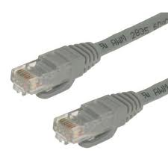
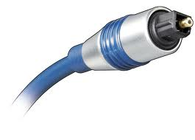
Physical Layer (1)
Application
Present.
Session
Service: move information between two systems connected by a physical link
Interface: specifies how to send and receive bits
Protocol: coding scheme used to represent a bit, voltage levels, duration of a bit
Examples: coaxial cable, optical fiber links; transmitters, receivers
Transport
Network
Datalink
Physical
Datalink
layer
Datalink
layer
Transmission
medium
Physical Layer
Physical Layer
101010100110101110
101010100110101110

Slide 26
Datalink Layer (2)
Application
Present.
Session
Transport
Network
Datalink
Service:
Enable end hosts to exchange frames (atomic messages) on the same physical line or wireless link
Possible other services:
Arbitrate access to common physical media
May provide reliable transmission, flow control
Interface: send frames to other end hosts; receive frames addressed to end host
Protocols: addressing, Media Access Control (MAC) (e.g., CSMA/CD - Carrier Sense Multiple Access / Collision Detection)
Physical

Slide 27
Datalink Layer (2)
Application
Present.
Session
Each frame has a header which contains a source and a destination MAC address
MAC (Media Access Control) address
Uniquely identifies a network interface
48-bit, assigned by the device manufacturer
Transport
Network
Datalink
Physical
MAC Dest. Address
MAC Src. Address
…
Network
Layer
Network
Layer
Datalink Layer
Frame
Hdr.
Frame Payload
Frame
Hdr.
Frame Payload
Datalink Layer
Physical Layer
Physical Layer
101010100110101110
101010100110101110

Slide 28
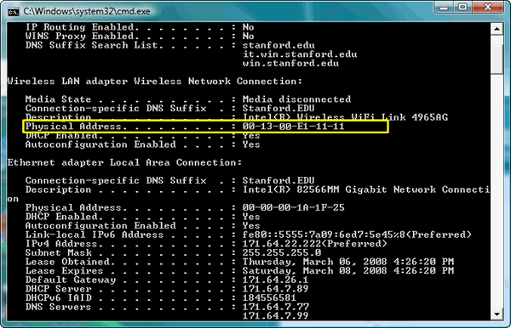
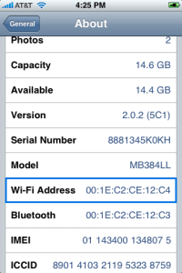
MAC Address Examples
Application
Present.
Session
Can easily find MAC addr. on your machine/device:
E.g., ifconfig (Linux, Mac OS X), ipconfig (Windows)
Transport
Network
Datalink
Physical
Wi-Fi MAC address
Wired/Ethernet MAC address

Slide 29
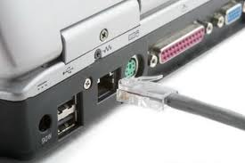
Local Area Networks (LANs)
Application
Present.
Session
LAN: group of hosts/devices that
are in the same geographical proximity (e.g., same building, room)
use same physical communication technology
Examples:
all laptops connected wirelessly at a Starbucks café
all devices and computers at home
all hosts connected to wired Ethernet in an office
Transport
Network
Datalink
Physical
Ethernet cable and port

Slide 30



LANs
Application
Present.
Session
All hosts in a LAN can share same physical communication media
Also called, broadcast channel
Each frame is delivered to every host
If a host is not the intended recipient, it drops the frame
Transport
Network
Datalink
Physical
MAC Addr: A
MAC Addr: B
MAC Addr: C
B
B

Slide 31
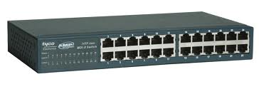

Switches
Application
Present.
Session
Hosts in same LAN can be also connected by switches
A switch forwards frames only to intended recipients
Far more efficient than broadcast channel
Transport
Network
Datalink
Physical
MAC Addr: B
MAC Addr: D
Switch
MAC Addr: C
MAC Addr: A
B

Slide 32
Media Access Control (MAC) Protocols
Application
Present.
Session
Transport
Problem:
How do hosts access a broadcast media?
How do they avoid collisions?
Three solutions:
Channel partition
“Taking turns”
Random access
Network
Datalink
Physical

Slide 33
MAC Protocols
Application
Present.
Session
Channel partitioning protocols:
Allocate 1/N bandwidth to every host
Share channel efficiently and fairly at high load
Inefficient at low load (where load = # senders):
1/N bandwidth allocated even if only 1 active node!
E.g., Frequency Division Multiple Access (FDMA); optical networks
“Taking turns” protocols:
Pass a token around active hosts
A host can only send data if it has the token
More efficient at low loads: single node can use >> 1/N banwidth
Overhead in acquiring the token
Vulnerable to failures (e.g., failed node or lost token)
E.g., Token ring
Transport
Network
Datalink
Physical

Slide 34
MAC Protocols
Application
Present.
Session
Random Access
Efficient at low load: single node can fully utilize channel
High load: collision overhead
Key ideas of random access:
Carrier sense (CS)
Listen before speaking, and don’t interrupt
Checking if someone else is already sending data
… and waiting till the other node is done
Collision detection (CD)
If someone else starts talking at the same time, stop
Realizing when two nodes are transmitting at once
…by detecting that the data on the wire is garbled
Randomness
Don’t start talking again right away
Waiting for a random time before trying again
Examples: CSMA/CD, Ethernet, best known implementation
Transport
Network
Datalink
Physical

Slide 35
Administrivia
Project 3: initial design doc due today at 11:59PM
Midterm 3 coming up on Wed 4/25 6:30-8PM
All topics up to and including Lecture 23
Focus will be on Lectures 17 – 23 and associated readings, and Projects 3
But expect 20-30% questions from materials from Lectures 1-16
LKS 245, Hearst Field Annex A1, VLSB 2060, Barrows 20, Wurster 102 (see Piazza for your room assignment)
Closed book
2 pages hand-written notes both sides

Slide 36
Break

Slide 37
(Inter) Network Layer (3)
Application
Present.
Session
Service:
Deliver packets to specified network addresses across multiple datalink layer networks
Possible other services:
Packet scheduling/priority
Buffer management
Interface: send packets to specified network address destination; receive packets destined for end host
Protocols: define network addresses (globally unique); construct forwarding tables; packet forwarding
Transport
Network
Datalink
Physical

Slide 38
(Inter) Network Layer (3)
Application
Present.
Session
IP address: unique addr. assigned to network device
Assigned by network administrator or dynamically when host connects to network
Transport
Network
Datalink
Physical
Transport
Layer
IP Dest. Address
IP Src. Address
…
Transport
Layer
Network Layer
Net.
Hdr.
Net. Payload
Net.
Hdr.
Net. Payload
Network Layer
Frame Payload
Datalink Layer
Frame
Hdr.
Net.
Hdr.
Net. Payload
Frame
Hdr.
Net.
Hdr.
Net. Payload
Datalink Layer
Physical Layer
Physical Layer
101010100110101110
101010100110101110

Slide 39
Wide Area Network
Application
Present.
Session
Wide Area Network (WAN): network that covers a broad area (e.g., city, state, country, entire world)
E.g., Internet is a WAN
WAN connects multiple datalink layer networks (LANs)
Datalink layer networks are connected by routers
Different LANs can use different communication technology (e.g., wireless, cellular, optics, wired)
Transport
Network
Datalink
Physical
Host A
(IP A)
R4
Host B
(IP B)
R2
R3
R1

Slide 40
Routers
Forward each packet received on an incoming link to an outgoing link based on packet’s destination IP address (towards its destination)
Store & forward: packets are buffered before being forwarded
Forwarding table: mapping between IP address and the output link
incoming links
Router
outgoing links
Memory

Slide 41
Packet Forwarding
Application
Present.
Session
Upon receiving a packet, a router
read the IP destination address of the packet
consults its forwarding table → output port
forwards packet to corresponding output port
Transport
Network
Datalink
Physical
Host A
(IP A)
R4
Host B
(IP B)
IP B
R2
R3
R1

Slide 42

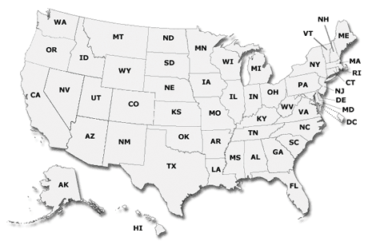

IP Addresses vs. MAC Addresses
Application
Present.
Session
Why not use MAC addresses for routing?
Doesn’t scale
Analogy
MAC address → SSN
IP address → (unreadable) home address
MAC address: uniquely associated to the device for the entire lifetime of the device
IP address: changes as the device location changes
Your notebook IP address at school is different from home
Transport
Network
Datalink
Physical
1051 Euclid Ave
Berkeley, CA 94722
10 7th Street NW
Washington, DC 21115

Slide 43

IP Addresses vs. MAC Addresses
Application
Present.
Session
Why does packet forwarding using IP addr. scale?
Because IP addresses can be aggregated
E.g., all IP addresses at UC Berkeley start with 0xA9E5, i.e., any address of form 0xA9E5**** belongs to Berkeley
Thus, a router in NY needs to keep a single entry for all hosts at Berkeley
If we were using MAC addresses the NY router would need to maintain an entry for every Berkeley host!!
Analogy:
Give this letter to person with SSN: 123-45-6789 vs.
Give this letter to “John Smith, 123 First Street, LA, US”
Transport
Network
Datalink
Physical

Slide 44

The Internet Protocol (IP)
Application
Present.
Session
Transport
Network
Internet Protocol: Internet’s network layer
Service it provides: “Best-Effort” Packet Delivery
Tries it’s “best” to deliver packet to its destination
Packets may be lost
Packets may be corrupted
Packets may be delivered out of order
Datalink
Physical
source
destination
IP network

Slide 45
Transport Layer (4)
Application
Present.
Session
Transport
Service:
Provide end-to-end communication between processes
Demultiplexing of communication between hosts
Possible other services:
Reliability in the presence of errors
Timing properties
Rate adaptation (flow-control, congestion control)
Interface: send message to specific process at given destination; local process receives messages sent to it
Protocol: port numbers, perhaps implement reliability, flow control, packetization of large messages, framing
Examples: TCP and UDP
Network
Datalink
Physical

Slide 46
Port Numbers
Application
Present.
Port number: 16-bit number identifying the end-point of a transport connection
E.g., 80 identifies the port on which a processing implementing HTTP server can be connected
Session
Transport
Network
Datalink
Physical
Transport Layer
Trans.
Hdr.
Data
Trans.
Hdr.
Data
Transport Layer
Network Layer
Net.
Hdr.
Trans.
Hdr.
Data
Net.
Hdr.
Trans.
Hdr.
Data
Network Layer
Datalink Layer
Frame
Hdr.
Net.
Hdr.
Trans.
Hdr.
Data
Frame
Hdr.
Net.
Hdr.
Trans.
Hdr.
Data
Datalink Layer
Physical Layer
Physical Layer
101010100110101110
101010100110101110

Slide 47
Internet Transport Protocols
Application
Present.
Session
Transport
Datagram service (UDP)
No-frills extension of “best-effort” IP
Multiplexing/Demultiplexing among processes
Reliable, in-order delivery (TCP)
Connection set-up & tear-down
Discarding corrupted packets (segments)
Retransmission of lost packets (segments)
Flow control
Congestion control
Services not available
Delay and/or bandwidth guarantees
Sessions that survive change-of-IP-address
Network
Datalink
Physical

Slide 48
Application Layer (7 - not 5!)
Application
Present.
Session
Transport
Service: any service provided to the end user
Interface: depends on the application
Protocol: depends on the application
Examples: Skype, SMTP (email), HTTP (Web), Halo, BitTorrent …
What happened to layers 5 & 6?
“Session” and “Presentation” layers
Part of OSI architecture, but not Internet architecture
Their functionality is provided by application layer
Network
Datalink
Physical

Slide 49
Application Layer (5)
Application Layer
Application Layer
Data
Data
Transport Layer
Trans.
Hdr.
Data
Trans.
Hdr.
Data
Transport Layer
Network Layer
Net.
Hdr.
Trans.
Hdr.
Data
Net.
Hdr.
Trans.
Hdr.
Data
Network Layer
Datalink Layer
Frame
Hdr.
Net.
Hdr.
Trans.
Hdr.
Data
Frame
Hdr.
Net.
Hdr.
Trans.
Hdr.
Data
Datalink Layer
Physical Layer
Physical Layer
101010100110101110
101010100110101110

Slide 50
Five Layers Summary
Lower three layers implemented everywhere
Top two layers implemented only at hosts
Logically, layers interacts with peer’s corresponding layer
Application
Application
Transport
Transport
Network
Network
Network
Datalink
Datalink
Datalink
Physical
Physical
Physical
Host A
Router
Host B

Slide 51
Physical Communication
Communication goes down to physical network
Then from network peer to peer
Then up to relevant layer
Application
Application
Transport
Transport
Network
Network
Network
Datalink
Datalink
Datalink
Physical
Physical
Physical
Host A
Router
Host B

Slide 52
The Internet Hourglass
SMTP
HTTP
DNS
NTP
Applications
TCP
UDP
Transport
Waist
IP
Data Link
Ethernet
SONET
802.11
Physical
Copper
Fiber
Radio
The Hourglass Model
There is just one network-layer protocol, IP.
The “narrow waist” facilitates interoperability.

Slide 53
Implications of Hourglass
Single Internet-layer module (IP):
Allows arbitrary networks to interoperate
Any network technology that supports IP can exchange packets
Allows applications to function on all networks
Applications that can run on IP can use any network
Supports simultaneous innovations above and below IP
But changing IP itself, i.e., IPv6, very involved

Slide 54
Drawbacks of Layering
Layer N may duplicate layer N-1 functionality
E.g., error recovery to retransmit lost data
Layers may need same information
E.g., timestamps, maximum transmission unit size
Layering can hurt performance
E.g., hiding details about what is really going on
Some layers are not always cleanly separated
Inter-layer dependencies for performance reasons
Some dependencies in standards (header checksums)
Headers start to get really big
Sometimes header bytes >> actual content

Slide 55
Placing Network Functionality
Hugely influential paper: “End-to-End Arguments in System Design” by Saltzer, Reed, and Clark (‘84)
“Sacred Text” of the Internet
Endless disputes about what it means
Everyone cites it as supporting their position

Slide 56
Basic Observation
Some types of network functionality can only be correctly implemented end-to-end
Reliability, security, etc
Because of this, end hosts:
Can satisfy the requirement without network’s help
Will/must do so, since can’t rely on network’s help
Therefore don’t go out of your way to implement them in the network

Slide 57
Example: Reliable File Transfer
Host A
Host B
Appl.
Appl.
OS
OK
OS
Solution 1: make each step reliable, and then concatenate them
Solution 2: end-to-end check and try again if necessary

Slide 58
Discussion
Solution 1 is incomplete
What happens if memory is corrupted?
Receiver has to do the check anyway!
Solution 2 is complete
Full functionality can be entirely implemented at application layer with no need for reliability from lower layers
Is there any need to implement reliability at lower layers?
Well, it could be more efficient

Slide 59
End-to-End Principle
Implementing this functionality in the network:
Doesn’t reduce host implementation complexity
Does increase network complexity
Probably imposes delay and overhead on all applications, even if they don’t need functionality
However, implementing in network can enhance performance in some cases
E.g., very losy link

Slide 60
Conservative Interpretation of E2E
Don’t implement a function at the lower levels of the system unless it can be completely implemented at this level
Unless you can relieve the burden from hosts, don’t bother

Slide 61
Moderate Interpretation
Think twice before implementing functionality in the network
If hosts can implement functionality correctly, implement it in a lower layer only as a performance enhancement
But do so only if it does not impose burden on applications that do not require that functionality
This is the interpretation we are using

Slide 62
Summary (1/2)
Layered architecture powerful abstraction for organizing complex networks
Internet: 5 layers
Physical: send bits
Datalink: Connect two hosts on same physical media
Network: Connect two hosts in a wide area network
Transport: Connect two processes on (remote) hosts
Applications: Enable applications running on remote hosts to interact
Unified Internet layering (Application/Transport/ Internetwork/Link/Physical) decouples apps from networking technologies

Slide 63
Summary (2/2)
E2E argument encourages us to keep IP simple
If higher layer can implement functionality correctly, implement it in a lower layer only if
it improves the performance significantly for application that need that functionality, and
it does not impose burden on applications that do not require that functionality

